Slide 2
COMPANY OVERVIEW
WHAT IS STEALTH TINT ?
APPLICATIONS
Q & A

Slide 3
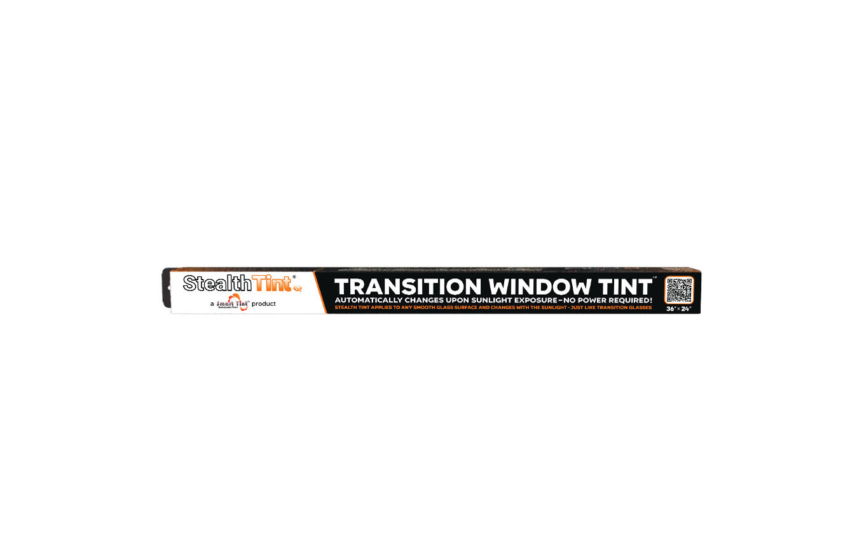
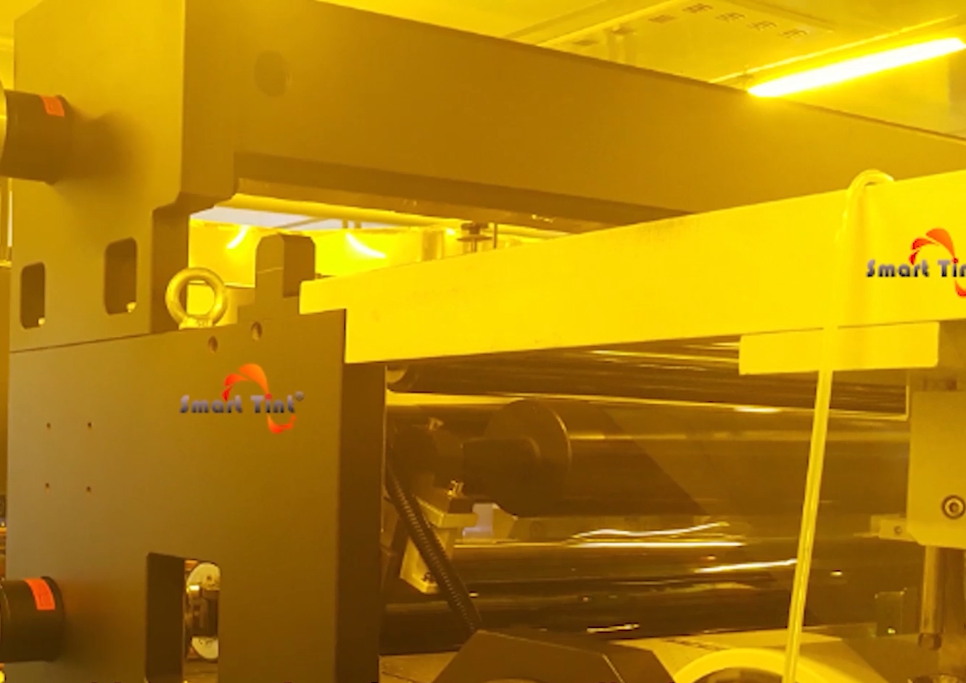
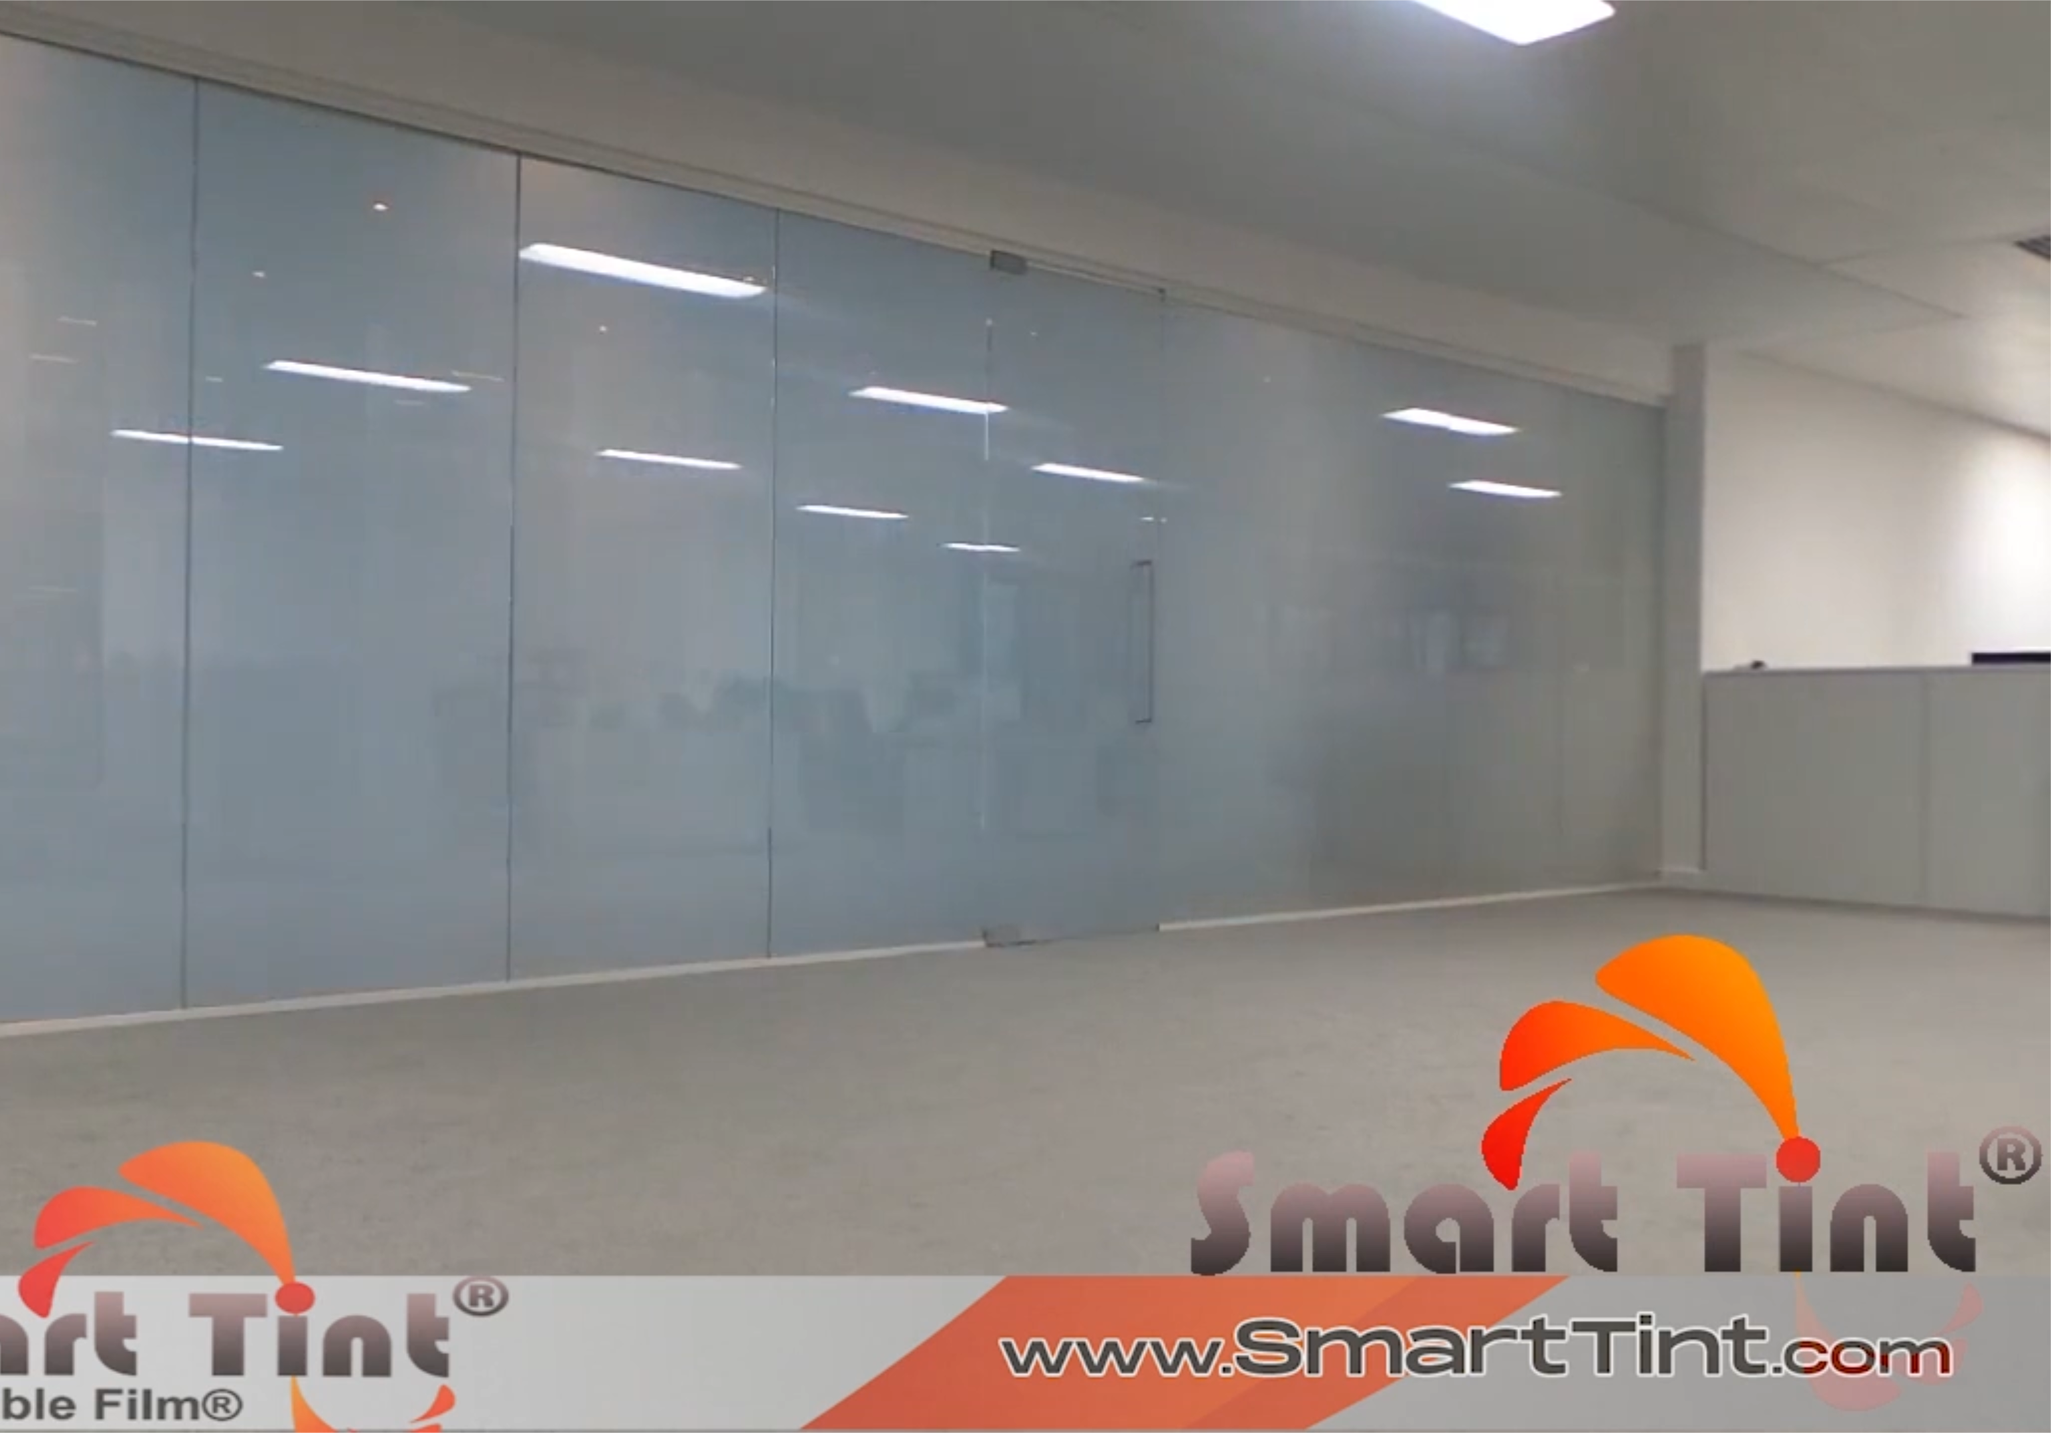
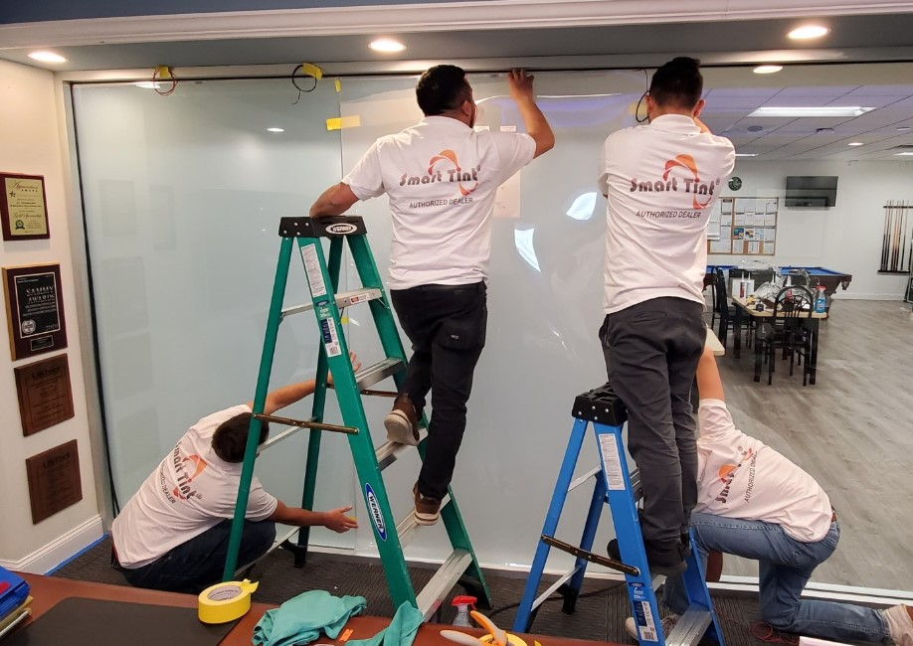
COMPANY OVERVIEW
WHAT IS STEALTH TINT ?
Smart Tint® is an Industry Leader - pioneering the Switchable Smart Film® industry since 1999
APPLICATIONS
Q & A
100% owned, operated & manufactured in the USA
Proprietary technology
Worldwide network of professional installers
Launching a new product line - Stealth Tint® Transition Window Tint
TM

Slide 4
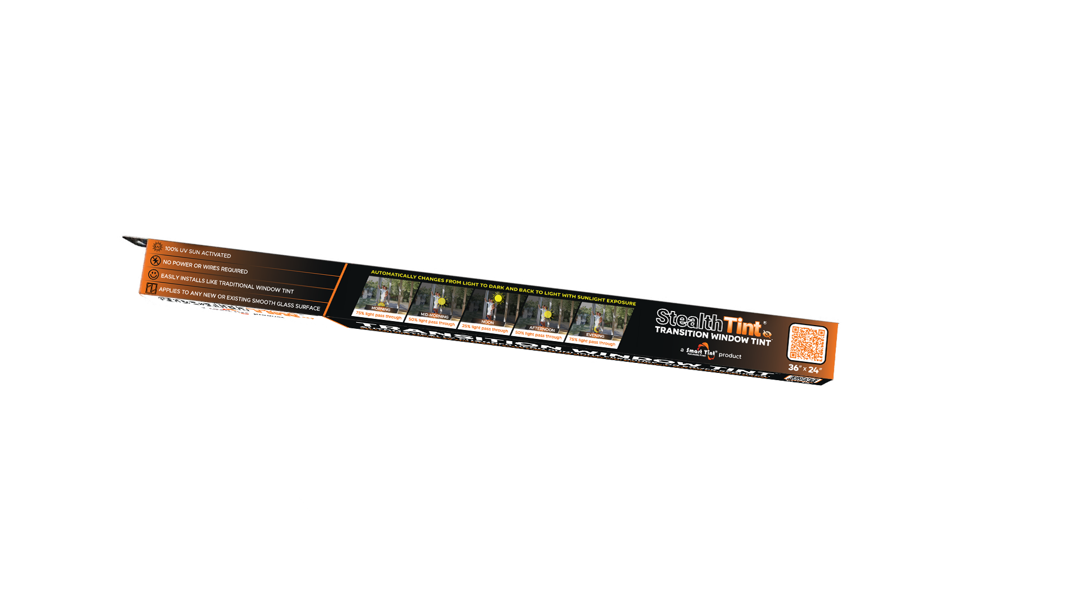
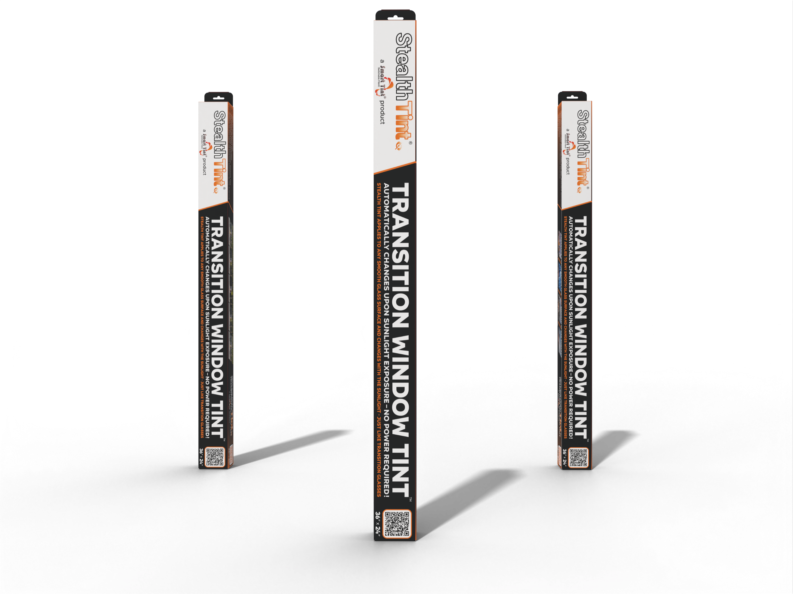
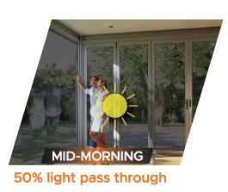
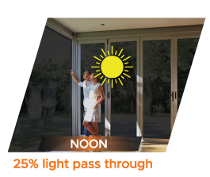
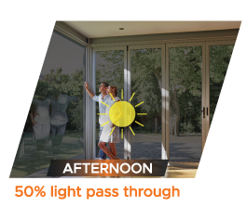
Automatically changes from light to dark and back to light with sunlight exposure
COMPANY OVERVIEW
WHAT IS STEALTH TINT ?
Smart Tint® is an Industry Leader - pioneering the Switchable Smart Film® industry since 1999
APPLICATIONS
Sunlight Activated Transition Window Tint
Q & A
100% owned, operated & manufactured in the USA
No Power Required
No Wires or Plugs
Proprietary technology
Worldwide network of professional installers
Small: (36″ x 24″)
100% UV Sun Activated
Launching a new product line - Stealth Tint® Transition Window Tint
Large: (36″ x “80)
TM
Medium: (36″ x 36″)

Slide 5
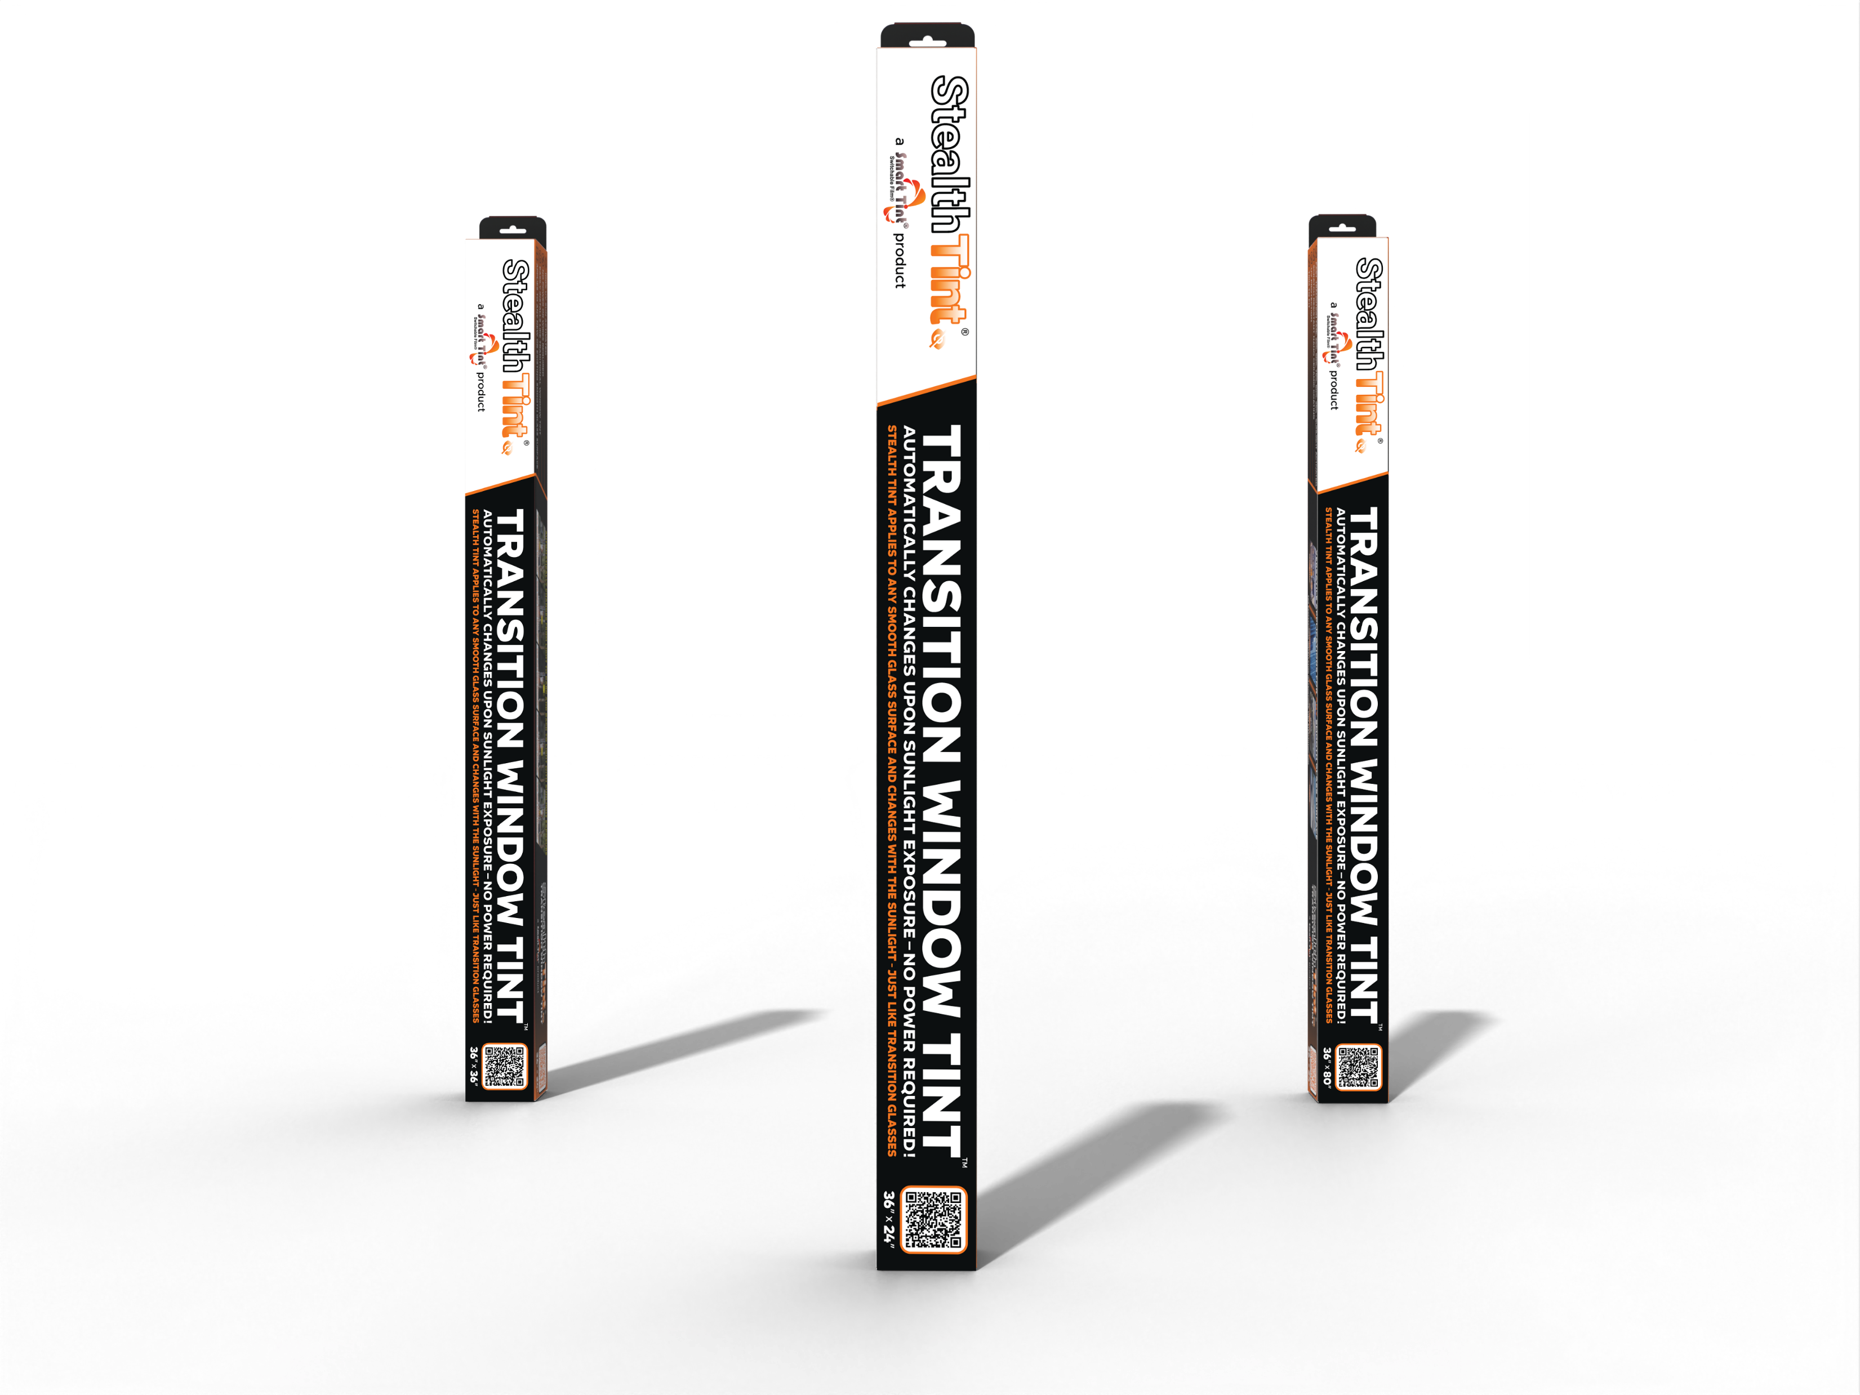
Automatically changes from light to dark and back to light with sunlight exposure
Three precut sizes
SMALL 36” x 24”
LARGE 36” x 80”
COMPANY OVERVIEW
WHAT IS STEALTH TINT ?
Smart Tint® is an Industry Leader - pioneering the Switchable Smart Film® industry since 1999
APPLICATIONS
Sunlight Activated Transition Window Tint
MEDIUM 36” x 36”
Q & A
100% owned, operated & manufactured in the USA
Multiple Sizes
No Power Required
No Wires or Plugs
Proprietary technology
Worldwide network of professional installers
Small: (36″ x 24″)
100% UV Sun Activated
Launching a new product line - Stealth Tint® Transition Window Tint
Large: (36″ x “80)
TM
Medium: (36″ x 36″)

Slide 6
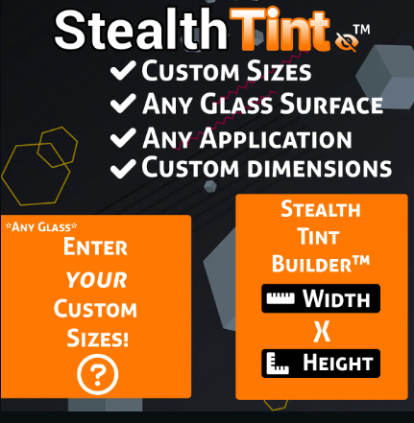
Custom Sizes, Shapes and Rolls available upon request for any application
COMPANY OVERVIEW
WHAT IS STEALTH TINT ?
Smart Tint® is an Industry Leader - pioneering the Switchable Smart Film® industry since 1999
APPLICATIONS
Sunlight Activated Transition Window Tint
Q & A
100% owned, operated & manufactured in the USA
Multiple Sizes
Proprietary technology
Worldwide network of professional installers
Small: (36″ x 24″)
Launching a new product line - Stealth Tint® Transition Window Tint
Large: (36″ x “80)
TM
Medium: (36″ x 36″)

Slide 7
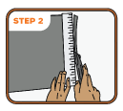
Clean
Trim
Wet
COMPANY OVERVIEW
WHAT IS STEALTH TINT ?
Peel
Place
Squeegee
Sunlight Activated Transition Window Tint
Multiple Sizes
Easy to Install
Trim to fit
Installs On Any Smooth Glass Surface
PEEL and Stick self-adhesive

Slide 8
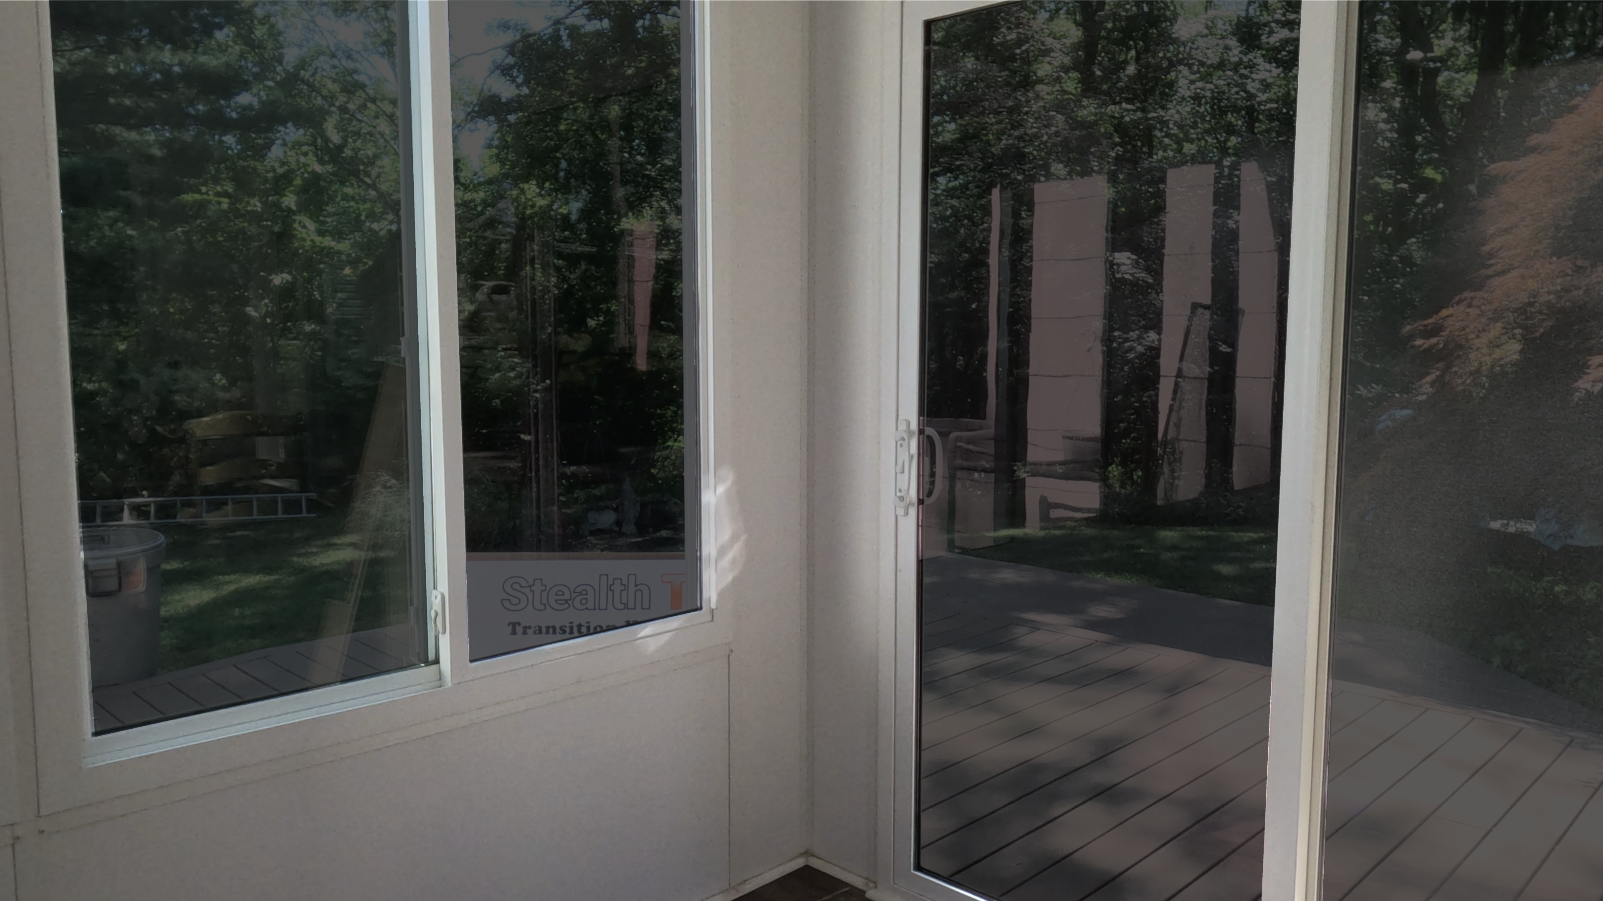
Clean
Trim
Wet
Fast Transition Time
Increased Privacy
COMPANY OVERVIEW
WHAT IS STEALTH TINT ?
Peel
Place
Squeegee
Sunlight Activated Transition Window Tint
Multiple Sizes
Reduced Glare
Easy to Install
Heat Rejection
Multiple Benefits
Installs On Any Smooth Glass Surface
PEEL and Stick self adhesive
UV Protection
Trim to fit

Slide 9
Fast Transition Time
Increased Privacy
COMPANY OVERVIEW
WHAT IS STEALTH TINT ?
AUTOMOTIVE
RESIDENTIAL
APPLICATIONS
Q & A
Versatile Applications for ANY Smooth Glass Surface
Reduced Glare
Heat Rejection
UV Protection
COMMERCIAL
MARINE

Slide 10
COMPANY OVERVIEW
WHAT IS STEALTH TINT ?
AUTOMOTIVE
RESIDENTIAL
APPLICATIONS
Q & A
COMMERCIAL
MARINE

